Slide 1
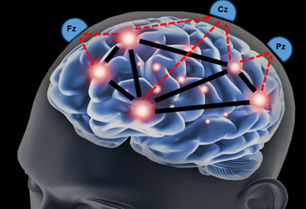
Brain Connectivity in Emotion Processing
By: Tapasi Brahma, Prabir Das, Ali Mohammadnezhad, Preet Lodaya, Abeera Ajaz, Mrittika Dey, Anudeep Vadrevu
Group: Emoti-Conn
Pod: Babute
TAs : Emeka Ogbuju, Ashish Sahoo
Project Mentor: Dr. Sven Bestmann

Slide 2
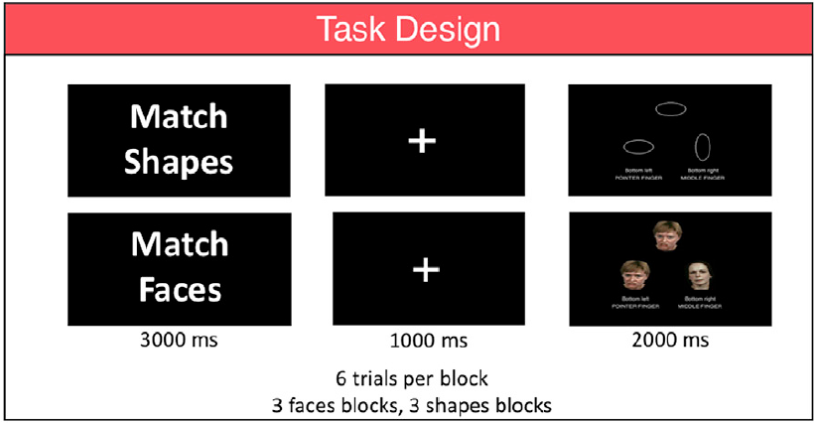
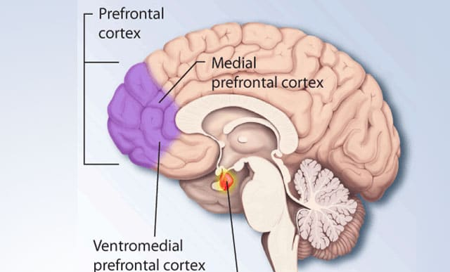
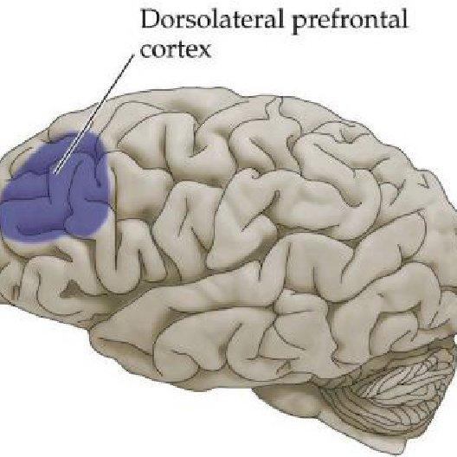
Background:
How are the brain regions believed to be associated with negative emotion processing?
Broadly, there are 4 regions of interest:
Insula
(8 ROIs)
Dorsolateral Prefrontal Cortex
(13 ROIs)
Hippocampus
(1 ROI)
Medial Prefrontal Cortex (15 ROIs)
Literature:
Hariri,A.R.,Tessitore,A.,Mattay,V.S.,Fera,F.,Weinberger,D.R.,2002.The amygdala response to emotional stimuli : a comparison of faces and scenes. Neuroimage 17, 317-323.
Matthew F.Glasser, Timothy S.Coalson, A Multi-modal Parcellation of Human Cerebral Cortex, Nature 536, 171-178 (2016)
Yasaman Shahhosseini and Michelle F. Miranda, Functional Connectivity Methods and Their Applications in fMRI Data

Slide 3
Hypothesis:
Q: Does the activity in the brain regions, associated with emotion, increase during emotion processing ?
Q: Does the functional connectivity between the brain regions, associated with emotion, increase during emotion processing ?
Q: Does the effective connectivity in the brain regions, associated with emotion, strengthens during emotion processing ?
“In this study, the BOLD activation, functional connectivity, and effective connectivity in brain regions, associated with emotions (Hippocampus, Insula, Medial Prefrontal Cortex, Dorsolateral Prefrontal Cortex), get enhanced during negative emotional (fear, anger) processing when compared with the neutral condition.”

Slide 4
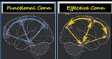
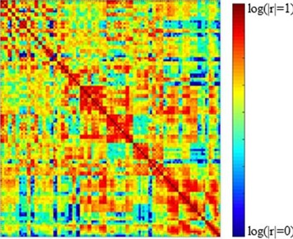
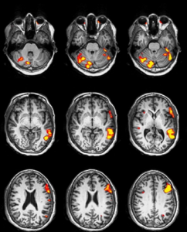
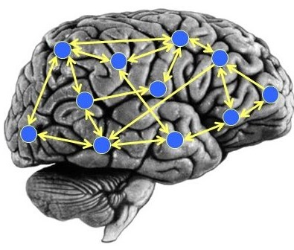
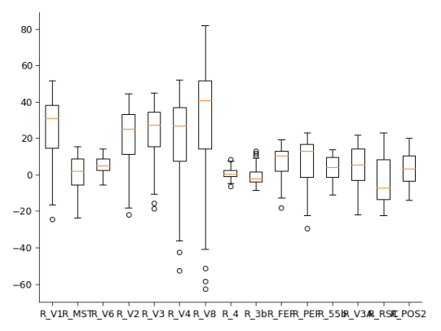
Methods:
Pearson Correlation
Difference in
Functional
Connectivity
Pre-Processed
Data
Statistical
Testing
(Bonferroni
p-values for func. conn.)
fMRI BOLD
Signals
Difference in
Effective
Connectivity
Comparison of
BOLD activation
during Emotion &
Neutral stimuli
Granger
Causality

Slide 5
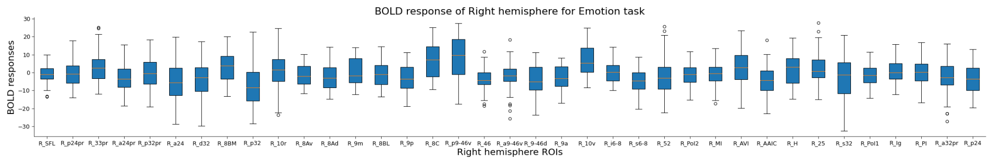
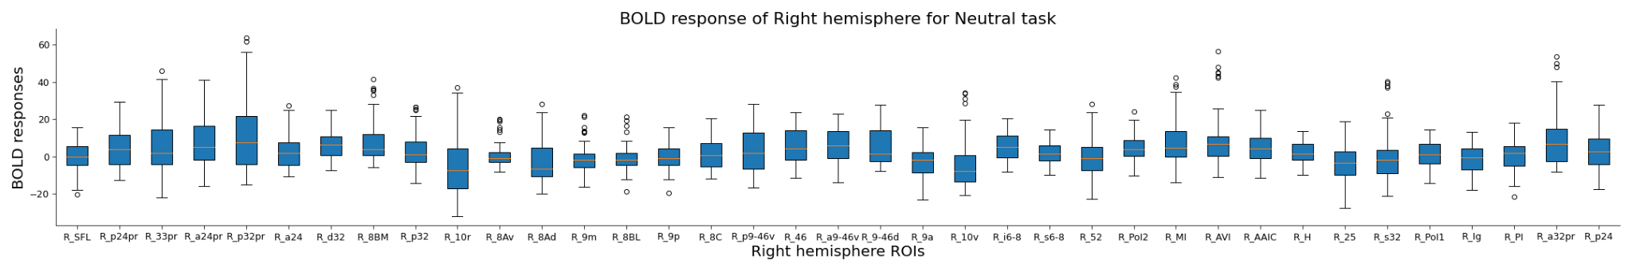
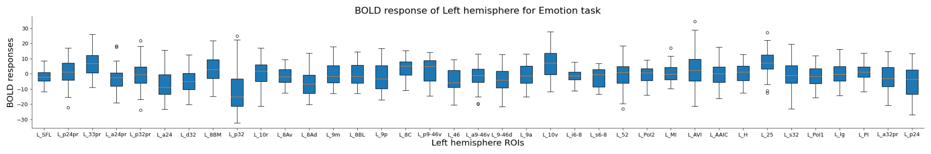
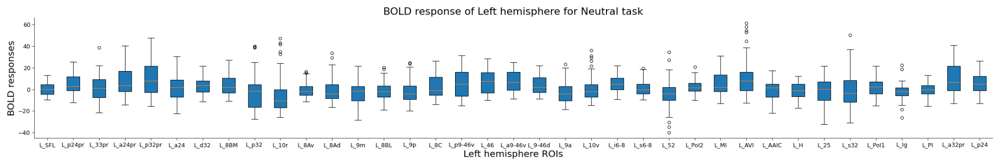
Results: a) BOLD Activity
Medial Prefrontal Cortex
Insula
Dorsolateral Prefrontal Cortex
Hippocampus

Slide 6
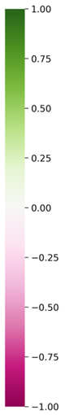
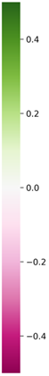
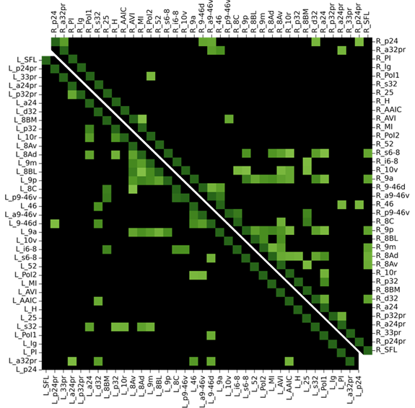
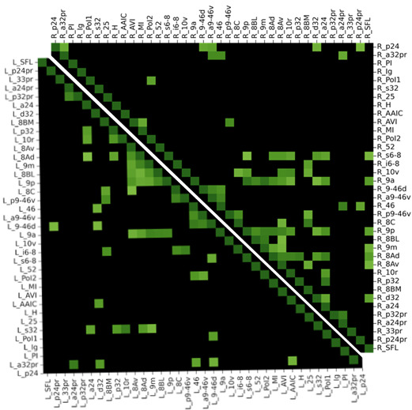
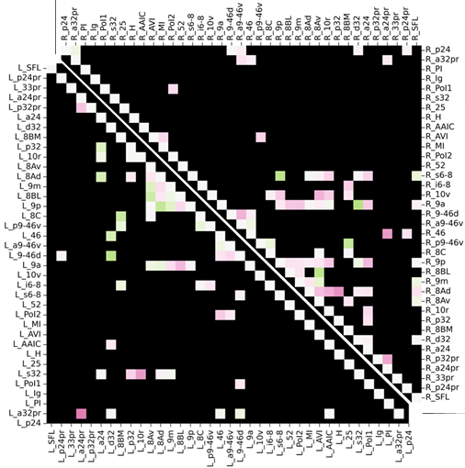
b) Functional Connectivity
Corr. for ROIs in right hemisphere
Correlation Matrices
Emotional Stimuli
Neutral Stimuli
Difference
Corr. for ROIs in left hemisphere

Slide 7
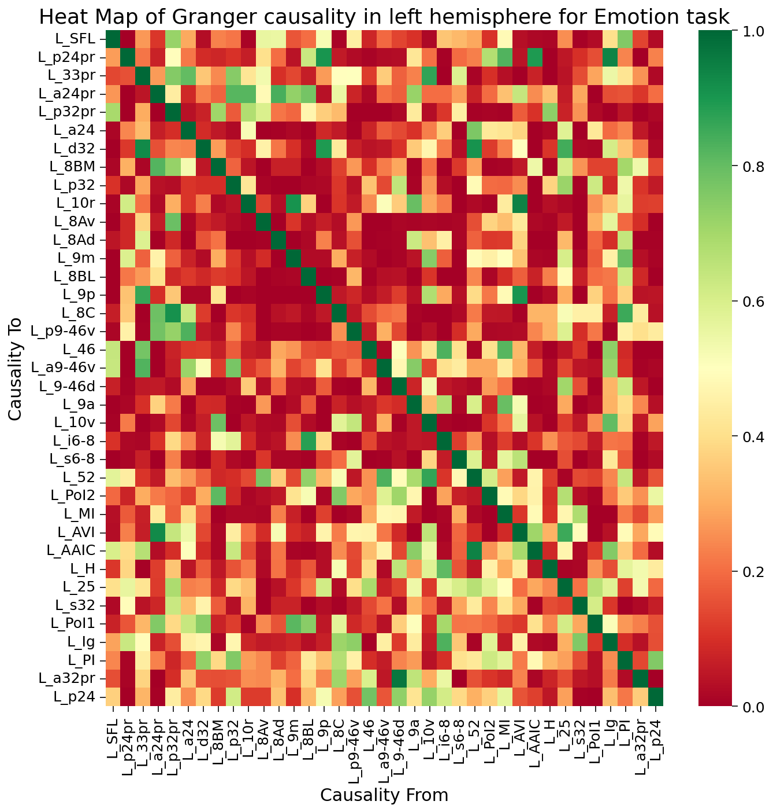
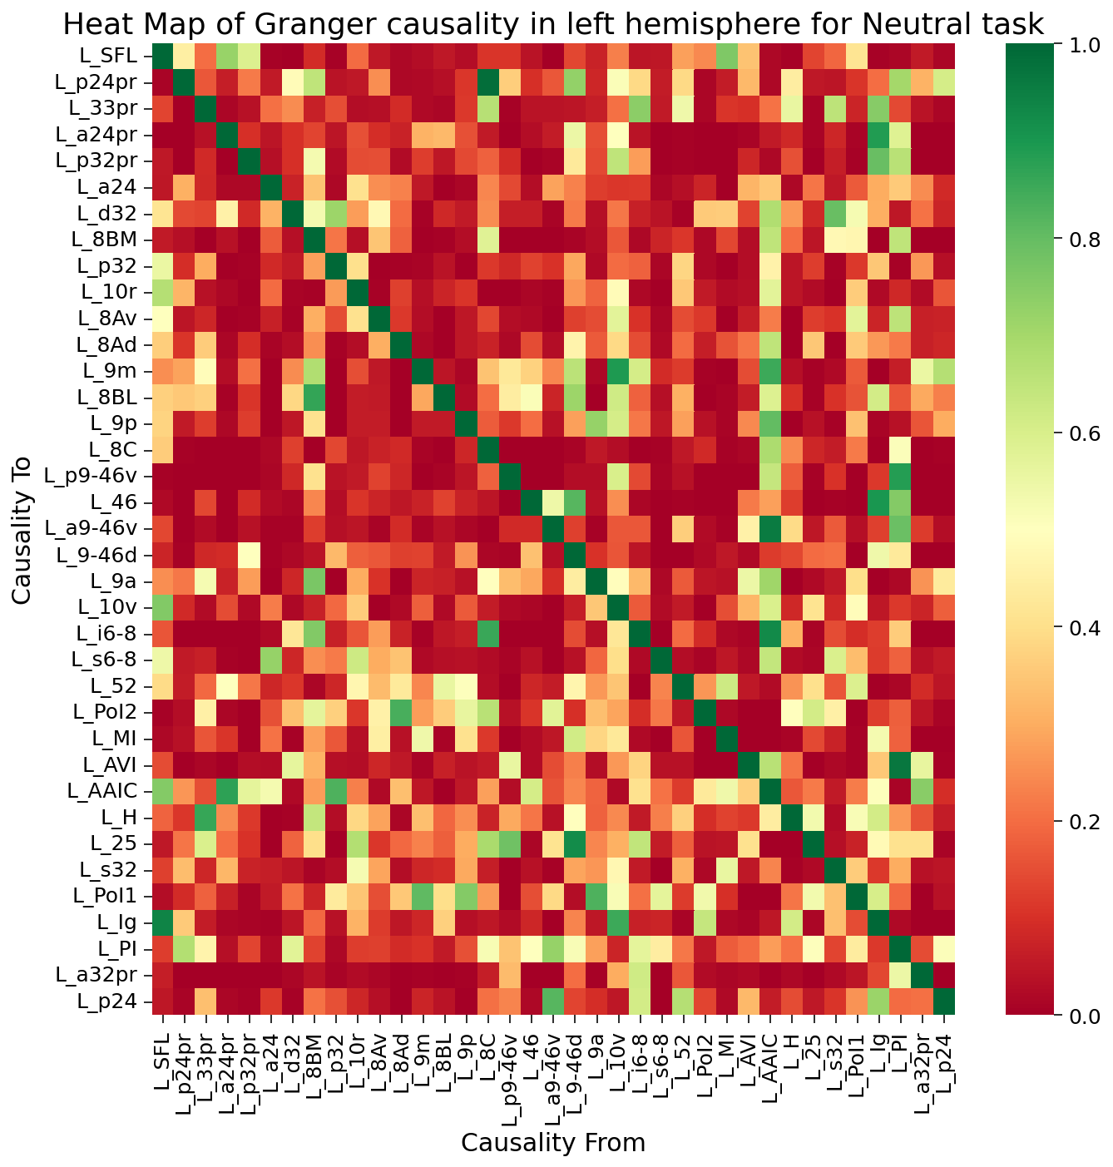
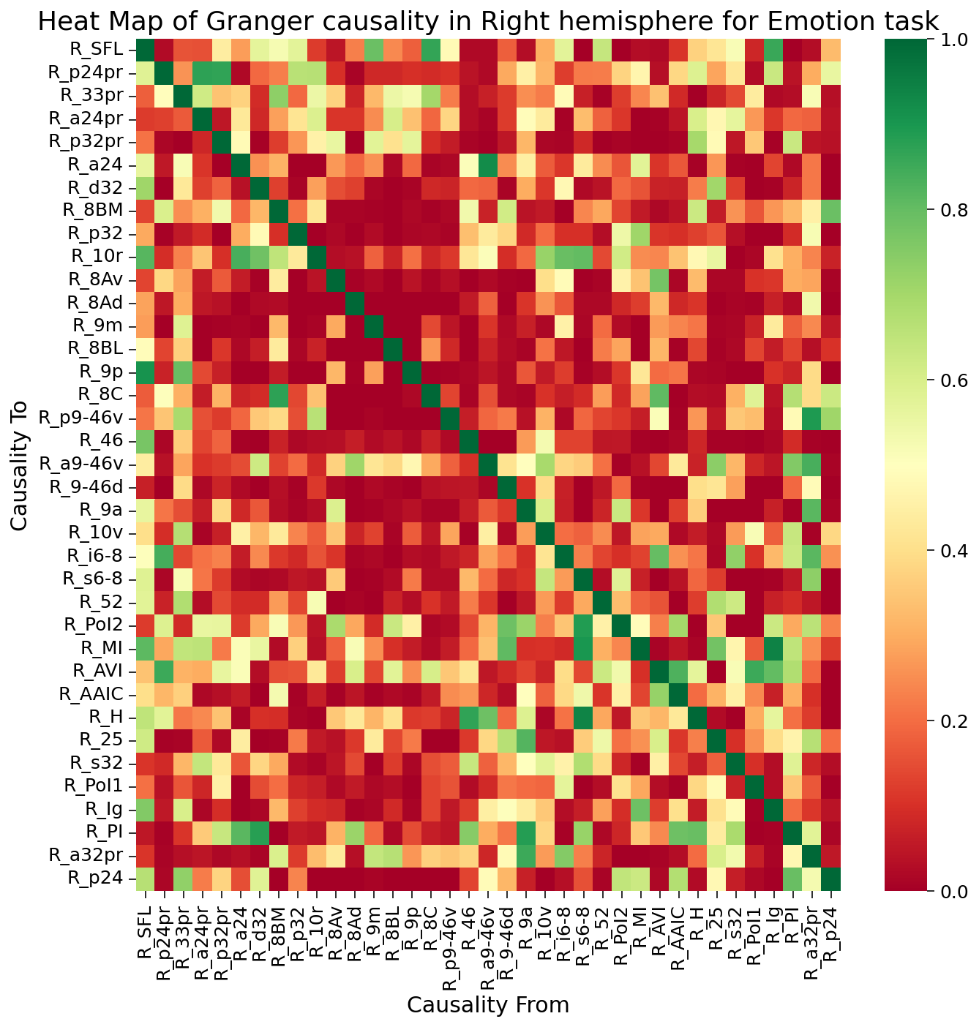
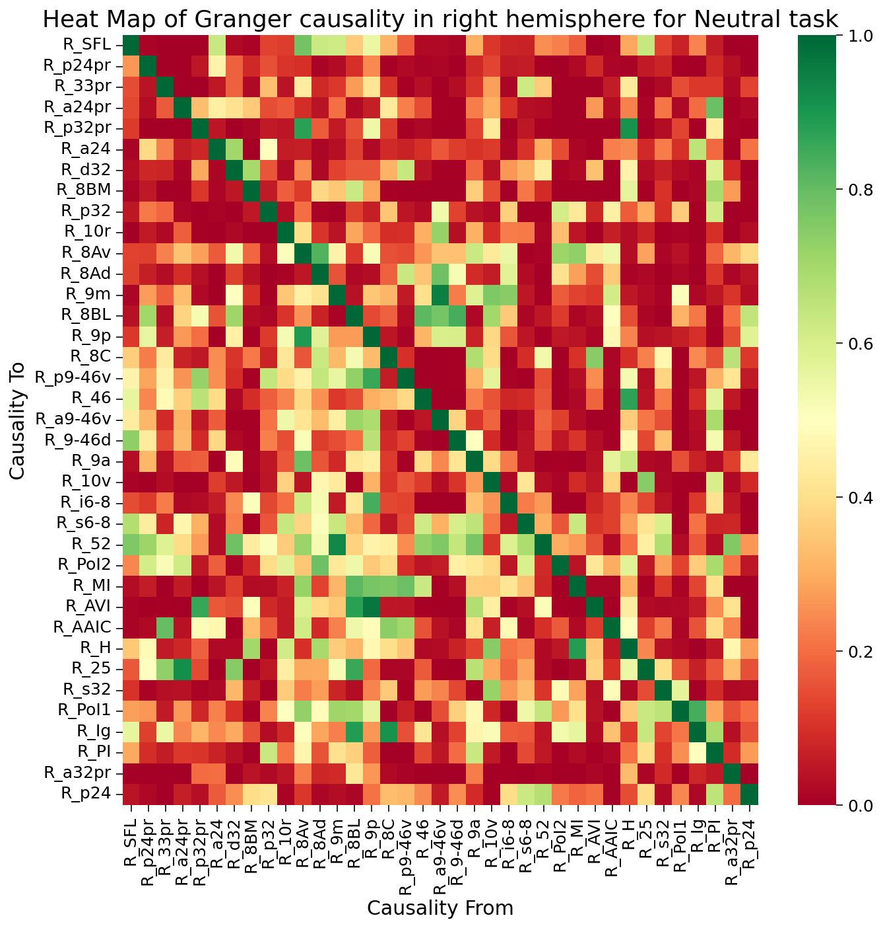
c) Effective Connectivity

Slide 8
Observation and Inference:
a) BOLD Activity: In most ROIs, BOLD activity is higher in emotion task compared to neutral task in both hemispheres:
Left hemisphere: Hippocampus, Dorsolateral Prefrontal Cortex, Insula, Medial Prefrontal Cortex
Right hemisphere: Hippocampus, Dorsolateral Prefrontal Cortex, Insula, Medial Prefrontal Cortex
b) Functional Connectivity:
The difference in func. conn. of shortlisted ROIs b/n 2 conditions is not statistically significant.
Could be attributed to assumptions of Pearson corr. and low threshold due to Bonferroni correction of p-value
c) Effective Connectivity:
Left hemisphere: Insula —>Medial Prefrontal Cortex, Insula—>Dorsolateral Prefrontal Cortex
Right hemisphere: Insula—>Medial Prefrontal Cortex, Medial Prefrontal Cortex—>Insula, Medial Prefrontal Cortex—>Medial Prefrontal Cortex

Slide 9
Conclusion and Future Scope:
Increase in BOLD activation among ROIs in Hippocampus, Insula, Medial Prefrontal Cortex, and Dorsolateral Prefrontal Cortex during negative emotional processing;
No significant difference in functional connectivity between negative emotional processing condition and neutral condition;
Increase in effective connectivity among ROIs in Insula, Medial Prefrontal Cortex, and Dorsolateral Prefrontal Cortex during negative emotional processing
Neuropsychiatric disorders affect emotional processing (E.g.: Autism)

Slide 10
THANK YOU!!

